Slide 1
Weather Station
Using Atmega328p as weather station with DHT11 sensor, Bluetooth module and Buzzer

Slide 2
Topics
PROJECT OVERVIEW
HARDWARE REQUIRED
2D VIEW
CODE STRUCTURE
TESTING PROJECT
CONCLUSION
THE END

Slide 3
Project Overview
Microcontroller Atmega328P
DHT11 sensor to get current Temperature and Humidity values.
Bluetooth module (as Slave) to transmit and receive data (USART).
Buzzer and LEDs are optional (controlled by Bluetooth).
Bluetooth receives integer value form Master Bluetooth module (only 1,2,3,4,5, & 6).
Notes:
Since everyone used Atmega328 I will be quick about it.
digital temperature and humidity sensor (measure the surrounding air)
6 will turn on the buzzer for few seconds.

Slide 4
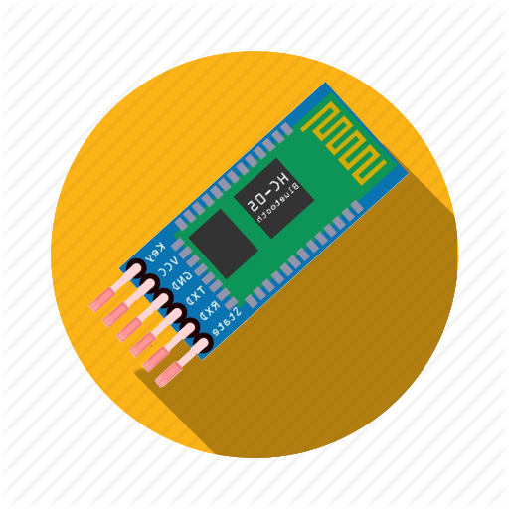

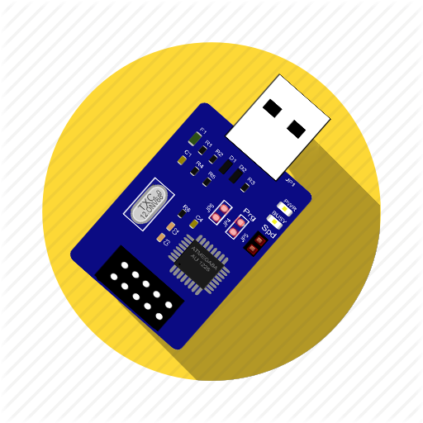





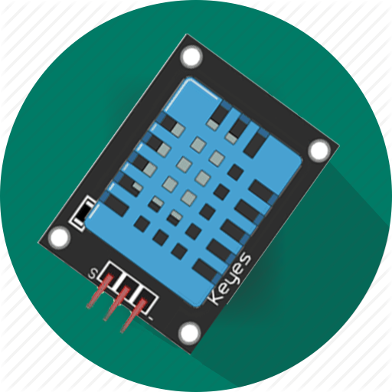
hardware required
Bluetooth HC-05
Jumper wires
USB AVR Programmer
Breadboard
LEDs (Green, Blue, & Red)
ATmega328P
Buzzer
DHT11
1kΩ resistor (x3)

Slide 5
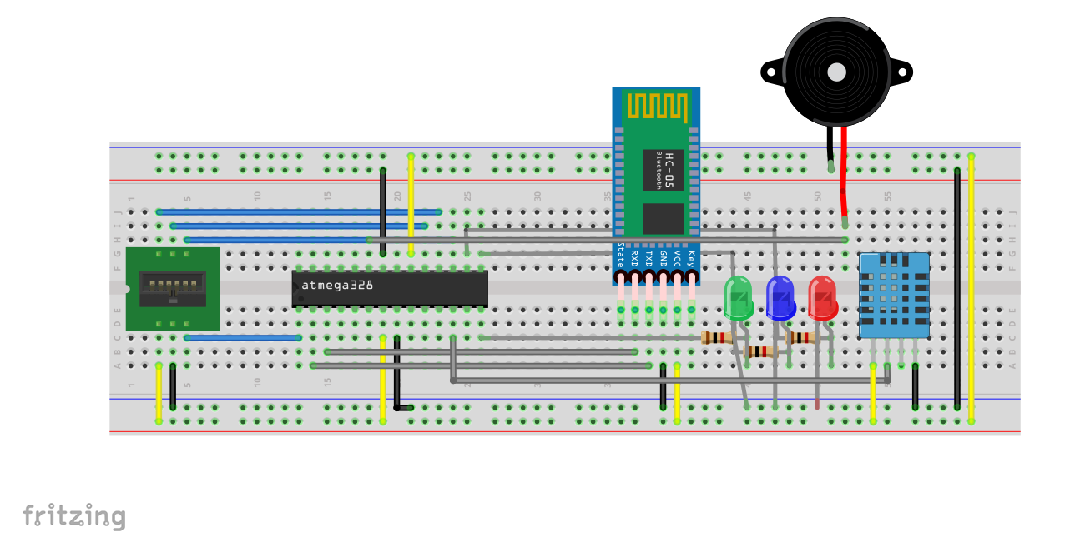
2D view
Notes:
Of my final project implementation and I made this by Fritzing program.
Explain the pins:
The Black wires are the GND
The Yellow wires are the VCC
The Bluetooth have connection with atmega328 as TX -> RX and Rx -> Tx
And the DHT11 connected to digital p-D6
And the Buzzer to P-C0
And LEDS to are connected to P-B0 and B1 and B2 respectiviy

Slide 6
Code Overview
B.T “Hello, Welcome”
Buzzer 3 sec. (Beeps!)
B.R (Read input as int)
delay 100 ms
If B.R == 1
If Pressed Turn OFF
Else Turn it ON
If B.R == 2
If B.R == 3
If Pressed Turn OFF
If B.R == 5
DHT11 -> Temperature
(In Celsius & Fahrenheit)
If B.R == 6
Buzzer - > Creepy tones! for few seconds.
If Pressed Turn OFF
Else Turn it ON
If B.R == 4
DHT11 -> Humidity
(In %)
Else Turn it ON
main
While Loop
Notes:
So brefly without explain any library or details
Just the main file

Slide 7
Testing Project
Time to Test The Project…
I will be quick, don't worry …

Slide 8
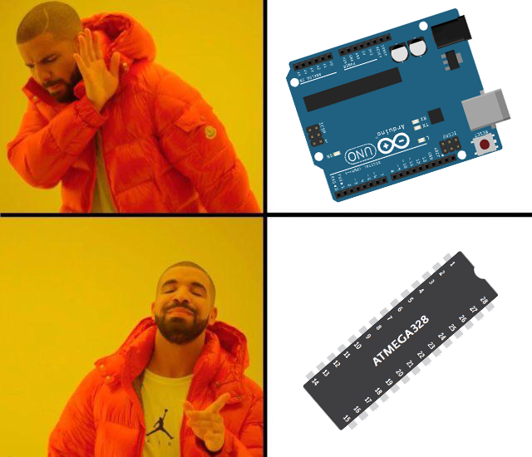
conclusion
It works…
I used a lot of Delays.
I learned a lot.
Notes:
I learned a lot.
My program was on and Off and a lot of delay.
I tried to use ADC and FastPWM and interrupt but it works it doesn’t matter now!

Slide 9

Any Question?
THE END

